Slide 1
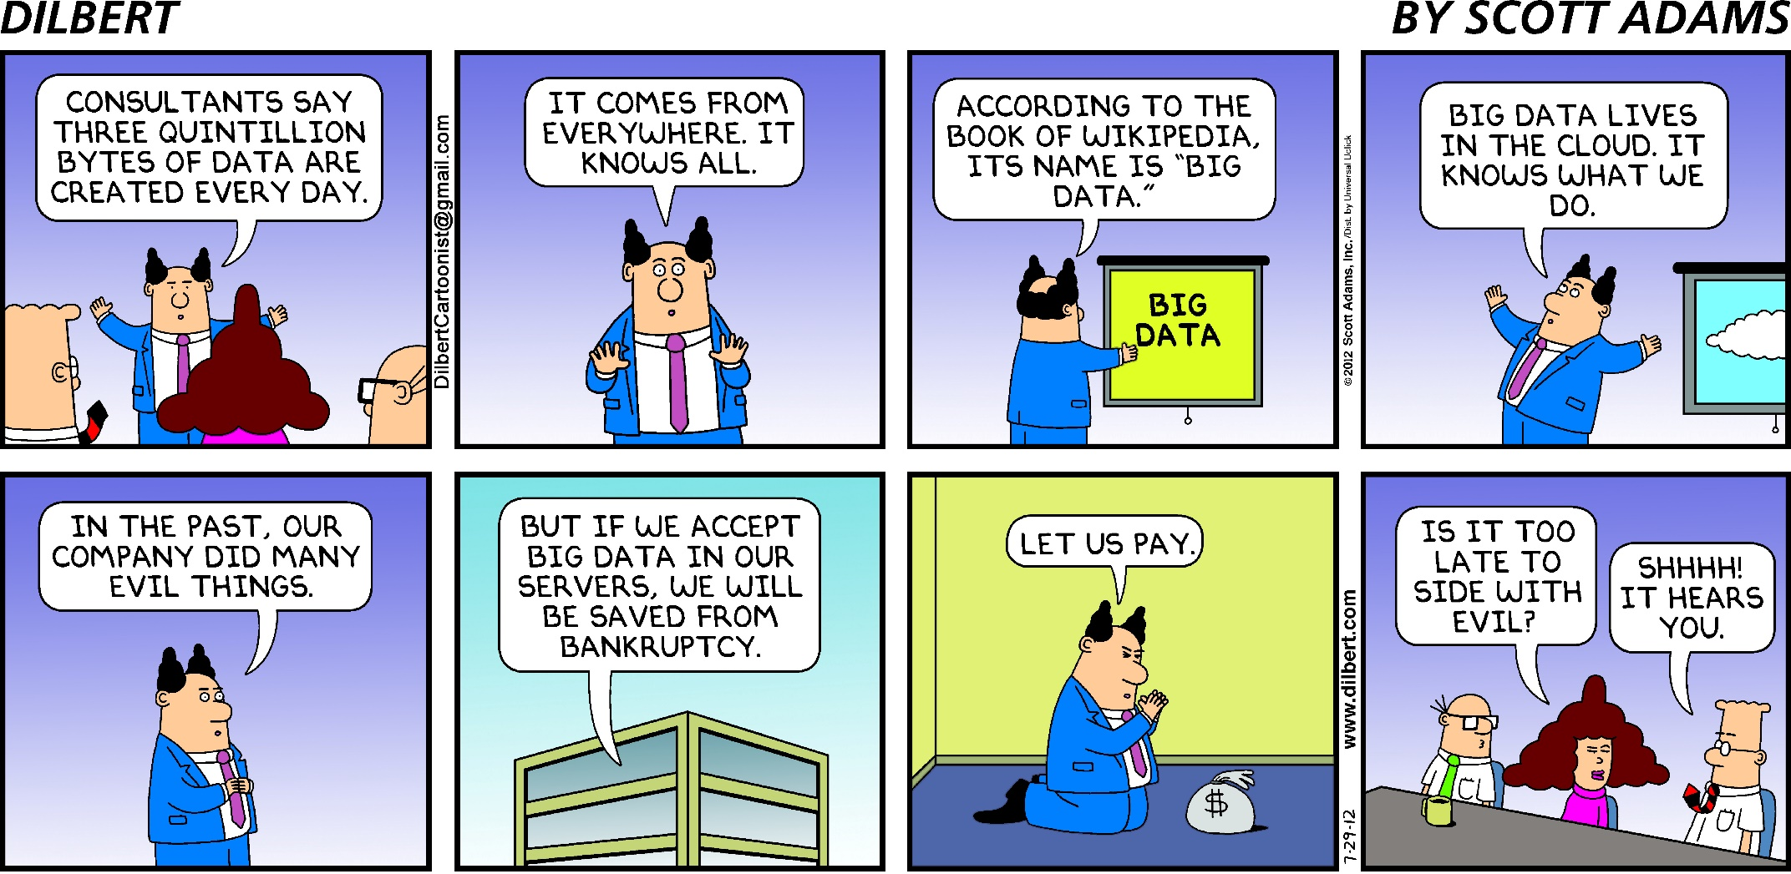
Notes:
for display while people arrive

Slide 2
Overview

Slide 3
What is Data Science?
Notes:
According to the hype, big data / data science will solve all our problems!

Slide 4
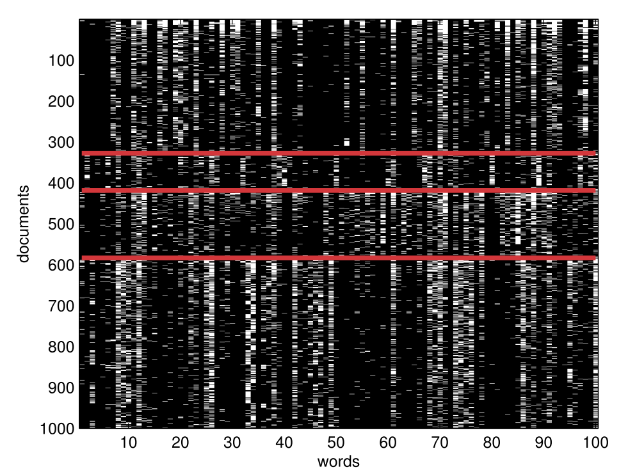
Ok, so what is it?
Machine Learning A Probabilistic Perspective - Kevin Murphy
Notes:
Really, it’s just about using statistics to find patterns in data.
Above we see a graphic showing the occurrence of 100 words in 1000 documents. Usenet comp, rec, sci (descending)
We're drowning in information and starving for knowledge.
- Rutherford D. Rogers

Slide 5
Goal for today
Data Science
What we will cover today
Notes:
Data Science is an enormous field
But don’t feel bad. As any data scientist will tell you, it takes a special kind of person understand this entire domain.
Here’s what they look like ...

Slide 6
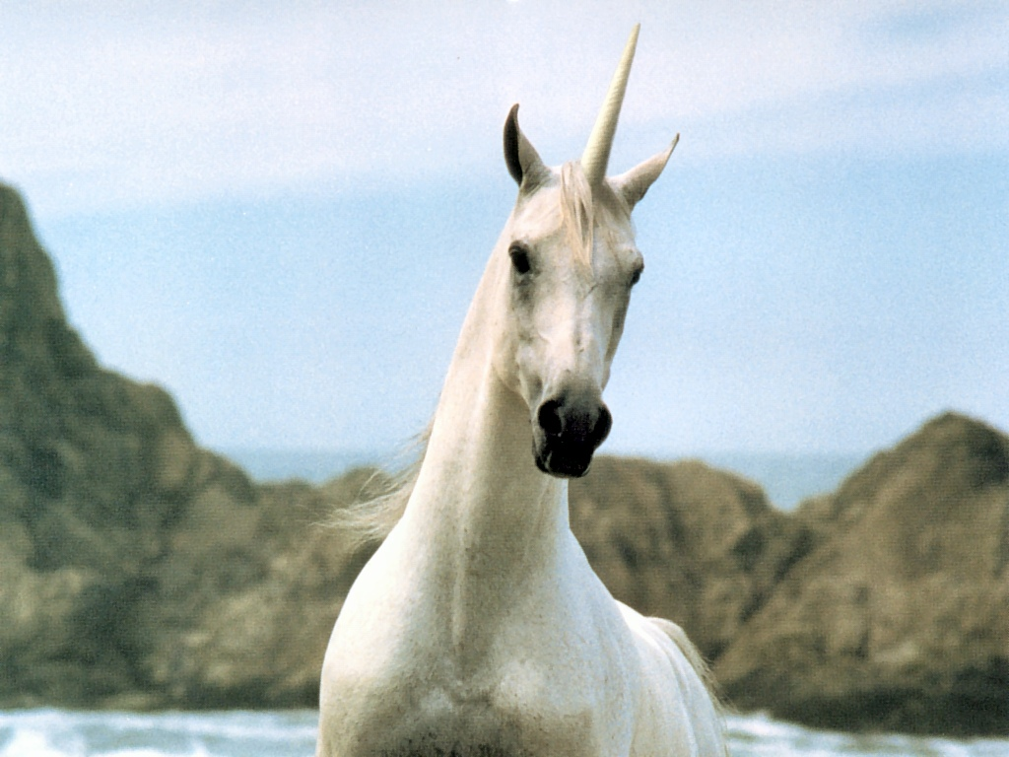
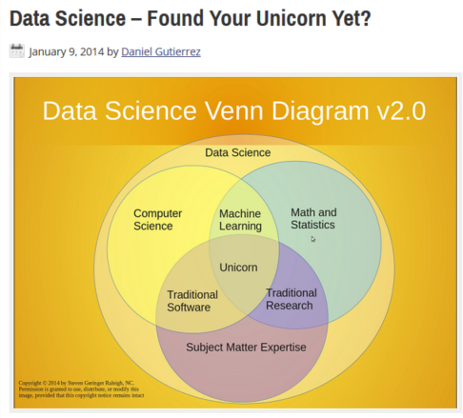
Notes:
My point is jump in and start learning!
There will always be more that you don’t know

Slide 7
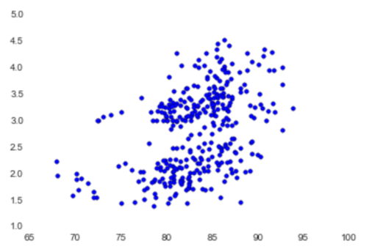
Goal for today
Question: Do schools with higher average teacher ratings have higher test results?
Here’s a teaser:
test scores
teacher rating
Notes:
I want to talk about two techniques today, and in order to do that, we need an interesting question, so we will continue to work with the NY teachers dataset and focus our attention on <Question>
I picked this question through some exploratory data analysis
I want to give you the tools to answer a question like this.
Why this question?

Slide 8
Goal for today
How do we get there?
Make statistics tangible
Kmeans Clustering
Linear Regression
Hands on with the data
Notes:
To answer the previous question, we need to become familiar with two techniques, KM and LR, and to do that we need a little recap on statistics, so this is the plan for our time.
-----
My goal for today is to increase you comfort level with statistical modeling and then introduce you to two techniques – Kmeans Clustering and Linear regression
Why KM and LR?
Spend a lot of time in excel getting our hands dirty with these things

Slide 9
Statistics
Notes:
Why spend time on statistics?
Because we all love statistics? no
statistics isn’t intuitive for anyone, if it were we wouldn’t have things like the birthday paradox.
Has anyone heard of this? Any guesses?
How many people do you need in a room before the probability of someone sharing a birthday is 50%?

Slide 10
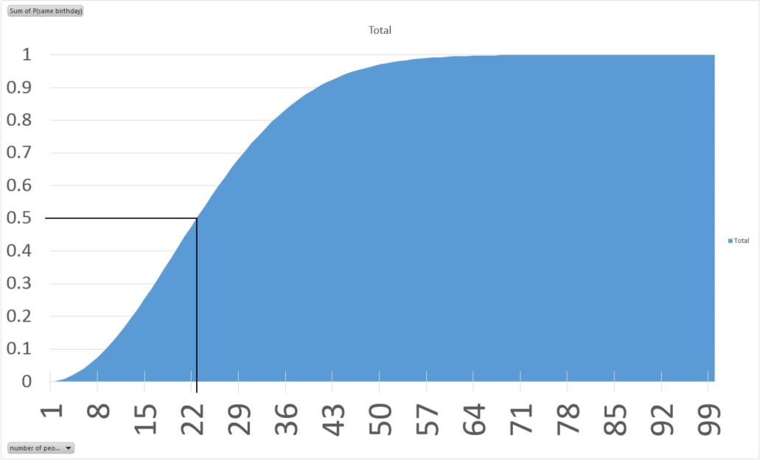
Birthday Paradox
Notes:
50% @ ~23 people

Slide 11
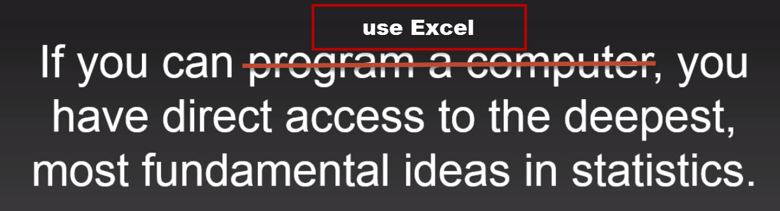
At it’s heart, Statistics isn’t complicated
Adapted from a talk at Strata Hadoop 2014 by John Rauser:
“Statistics Without the Agonizing Pain”
https://youtu.be/5Dnw46eC-0o?list=PL055Epbe6d5Y8_iZPo7pH3hOnAtchMCJt
Notes:
Using a computer allows us wade in and see what’s happening!
Let’s put that to the test with the birthday problem ... (excel demo)

Slide 12
Basic premise of data science
Data = Signal + Noise
Signal = knowledge we seek
Noise = some random process
Notes:
statistics is the basic tool of the data scientist to filter out the signal from the noise

Slide 13
Modeling Process
Create a model of the system
use data to test our model
Modify our model
Question
Notes:
We start with a question: Do the teacher ratings correspond to better results?
we create a model of how we think the system works, then use data to evaluate that model.
Later we will look at two types of models we might use: kmeans clustering and linear regression
This is great, but what do we do if we don’t know which model to use?
-------
But before we get there, let’s talk about how we learn to use models.

Slide 14
Learning a model technique
Pick a model
Apply it to data
Evaluate the results
Two scenarios:
Pick a model
Apply it to generated random data
Evaluate the results
Notes:
I will argue that the second approach is much more effective in evaluating the performance of models and learning their strengths and limitations.

Slide 15
Generating Random Data
Data = Signal + noise
To generate data, flip this:
Signal + noise = Data
Notes:
Let’s start to get a feeling for what randomness means and how we go about approximating it

Slide 16
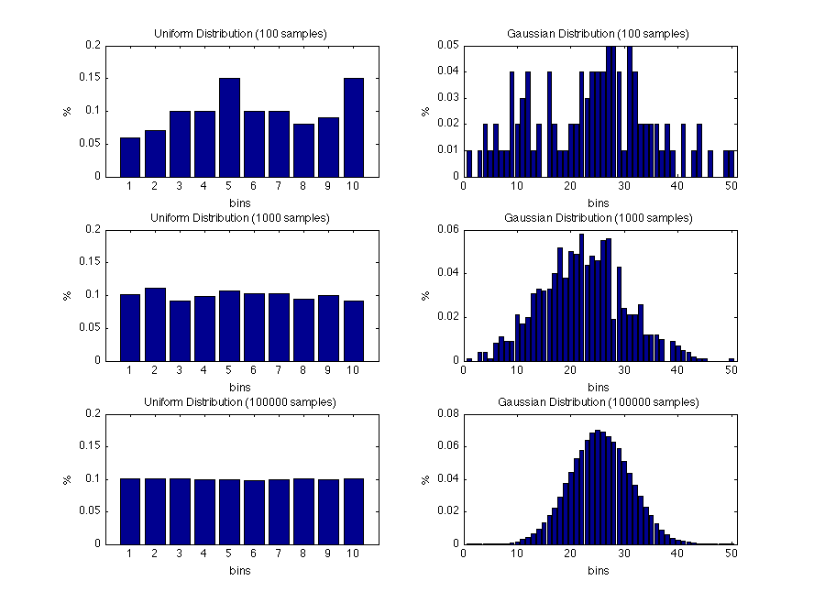
Two Examples of Randomness
Gaussian
Normal
Bell Curve
Uniform
Notes:
Randomness in one dimension:
point out # samples increase from top to bottom
these are two of the most commonly used distributions
Gaussian: not a bad first approximation
central limit theorem
Uniform: can be used to generate other distributions

Slide 17
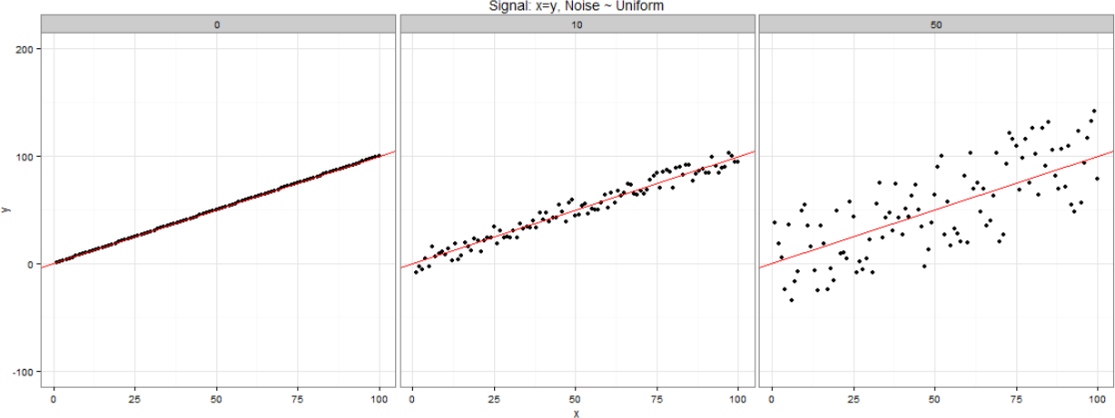
Signal + Uniform Noise
Notes:
Randomness in two dimensions
points spread evenly above and below signal

Slide 18
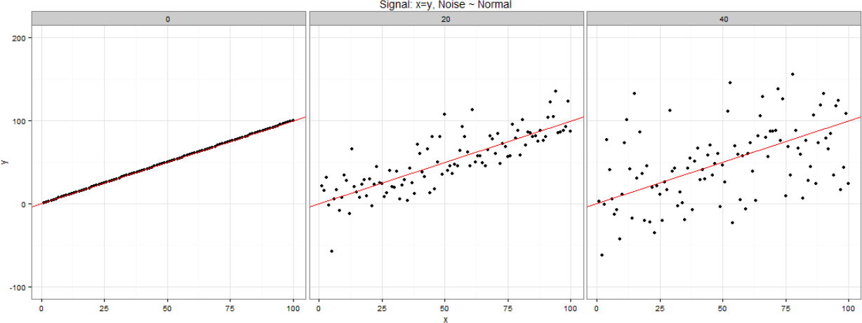
Signal + Normal Noise
Notes:
points farther away from signal

Slide 19
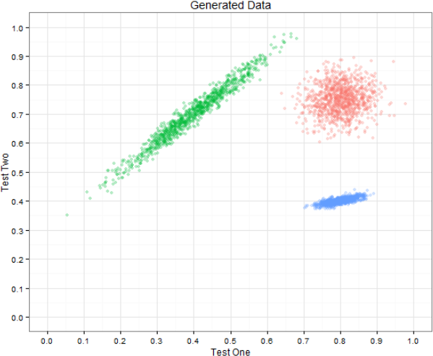
Generated Data
Notes:
Hands on in Excel generating data

Slide 20
Clustering
Notes:
Why spend time on statistics?
Because we all love statistics? no
statistics isn’t intuitive for anyone, if it were we wouldn’t have things like the birthday paradox.
Has anyone heard of this? Any guesses?
How many people do you need in a room before the probability of someone sharing a birthday is 50%?

Slide 21
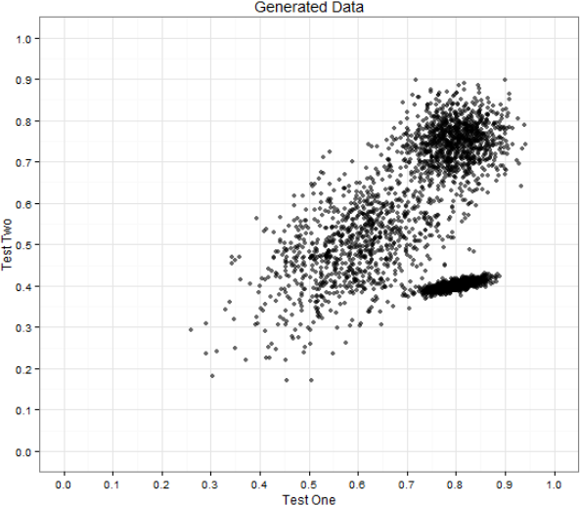
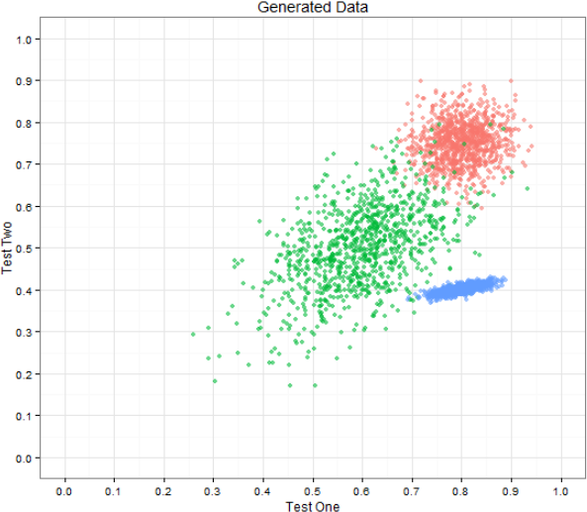
Supervised vs Unsupervised
Notes:
Clustering is an example of unsupervised learning
Maybe you’ve heard that term before: basically answers vs no answers

Slide 22
Clustering
Distance metric
Notes:
Clustering is an example of unsupervised learning
You can see right away that we’re going to have a little trouble distinguishing between these three groups, so if this is our only input, clustering may not be a good choice

Slide 23
Different distance metrics
Euclidean
cosine
Manhattan
Notes:
what I want you to remember is that there are quite a few different ways to measure distance, but they all work pretty much the same way. Define a metric group points that are close.

Slide 24
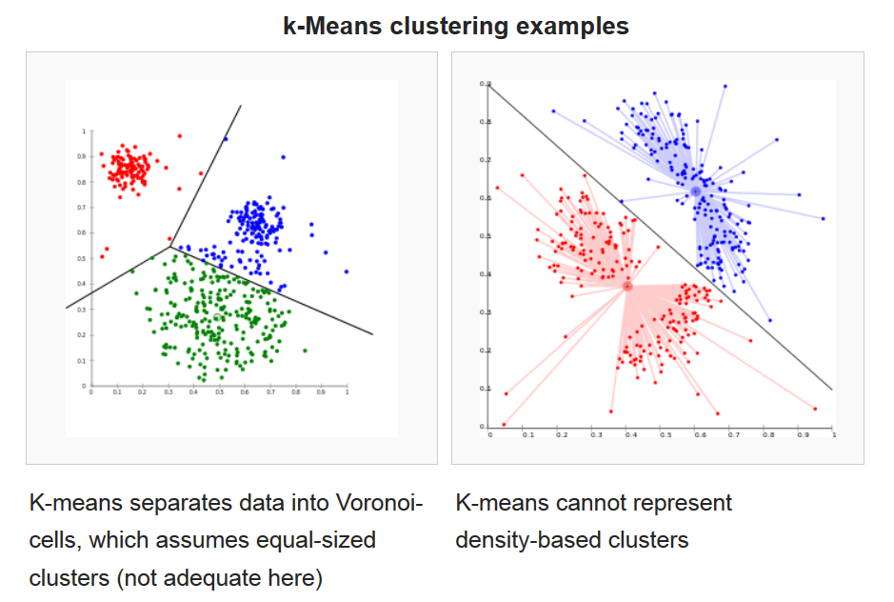
Kmeans
Notes:
Start with a technique called kmeans.

Slide 25
Generated Data
Notes:
To learn clustering, let’s go back to the data we generated

Slide 26
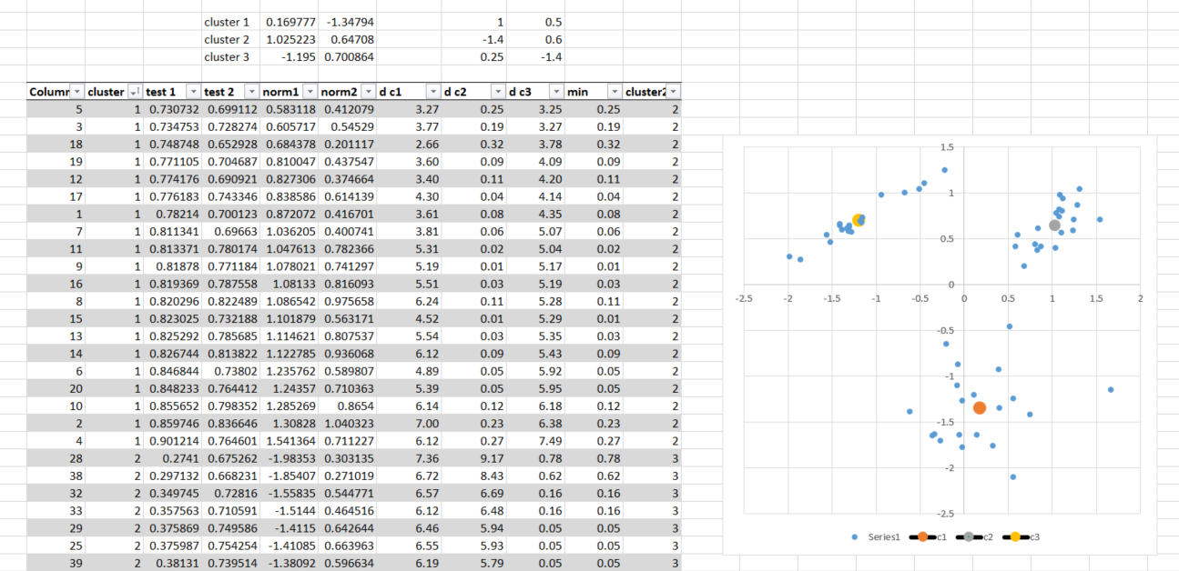
Clustering in Excel

Slide 27
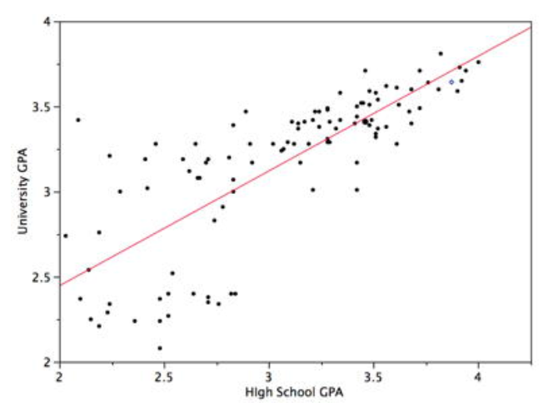
Regression
Notes:
Ok, so now what?
We see how we can separate data into groups. Sometimes, that’s enough, but a lot of times, we will want to look for a relationship within the groups of data.
e.g.
given the pitcher is left handed, what do we expect a player’s batting average to be.
given a person plays sports, how do we expect their height and weight to be related.
or in our generated data, given a person is in cluster X, how are test 1 and test 2 scores related?

Slide 28
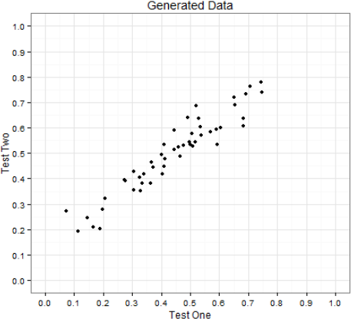
Linear Regression
Notes:
Intuitively it’s pretty obvious – it comes down to distance again

Slide 29
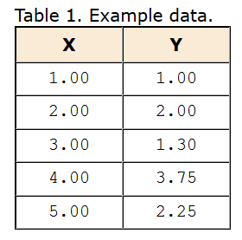
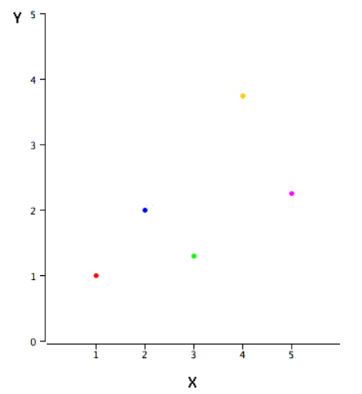
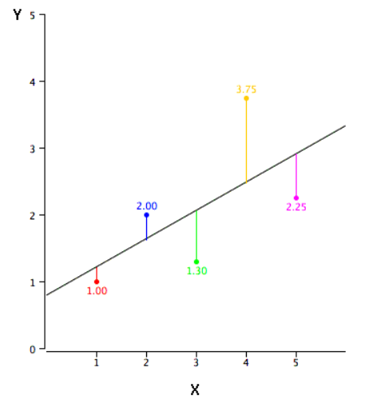
Simple Example
http://onlinestatbook.com/2/regression/intro.html

Slide 30
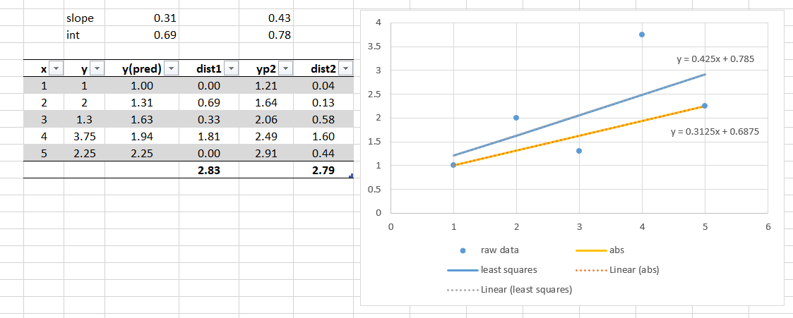
Simple Example in Excel

Slide 31
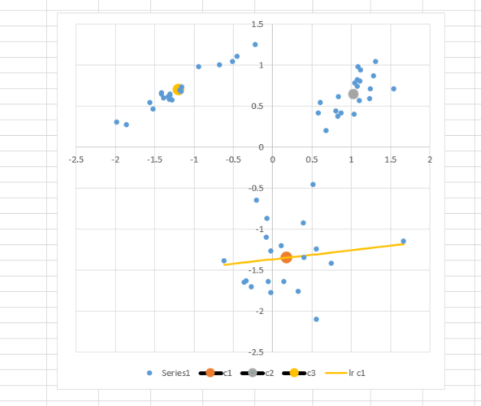
Back to our Toy Data

Slide 32
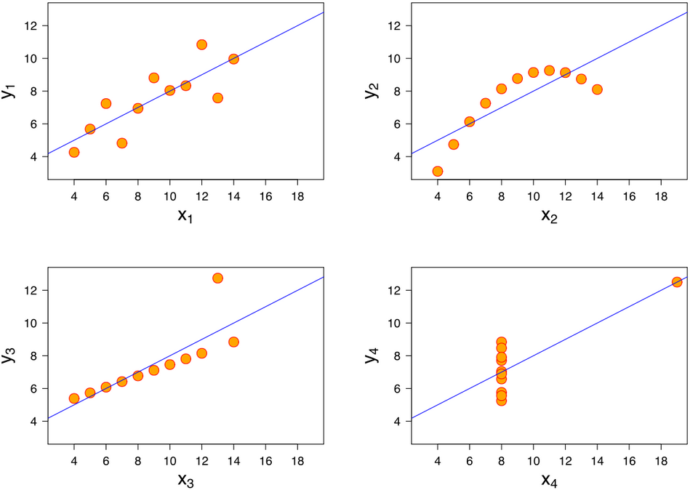
Evaluating the fit
BE AWARE!

Slide 33
R Squared Test

Slide 35
“... all models are wrong, but some are useful” – George Box

